Slide 1
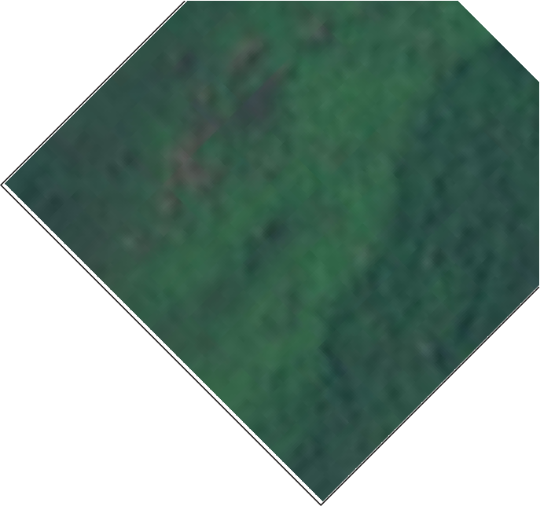

Land Cover Classification using Remote Sensing Data
Sahil S badve

Slide 2
1. Business Understanding | 2. Data Understanding
3. | 4.
Methods | Results
5. | 6.
Recommendations | Next Steps
Agenda

Slide 3
Problem Statement
The ongoing impacts of deforestation, urbanization, and agricultural expansion underscore the need for precise land cover classification. Traditional methods often lack accuracy and scalability, posing challenges for effective environmental management. This project leverages Convolutional Neural Networks (CNNs) to classify land cover types using satellite imagery, offering a more reliable solution. The results can support conservation efforts, guide sustainable urban planning, and optimize agricultural practices, contributing to better land use and environmental stewardship.

Slide 4
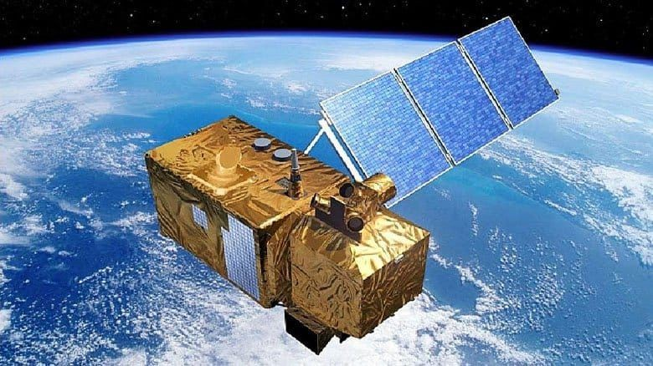
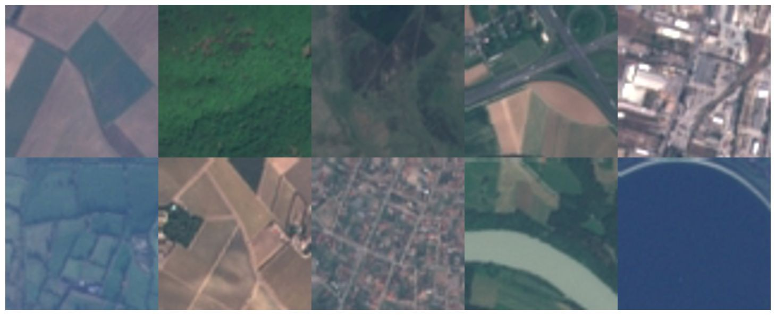
Data Understanding
27,000 RGB Satellite Images across 10 classes
Sentinel-2 Satellite which provided the data for this project
Annual Crop
Forest
Herbaceous Vegetation●
Highway
Industrial
Pasture
Permanent Crop Residential
River
Sea or Lake
Data examples is from the EuroSat benchmark dataset

Slide 5
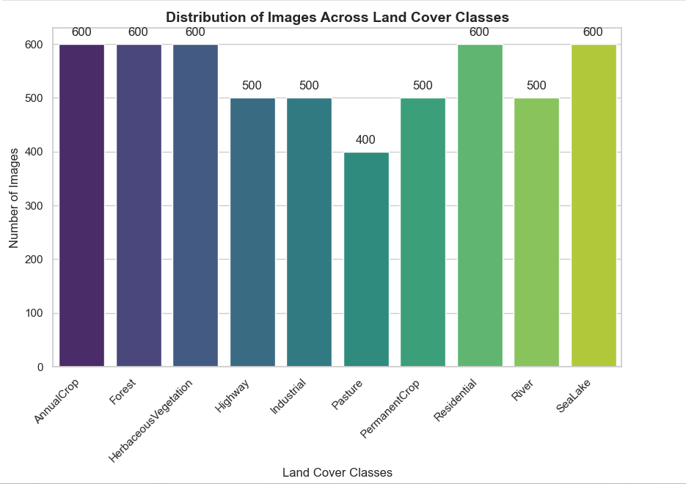
Class Distribution
Data examples is from the EuroSat benchmark dataset

Slide 6
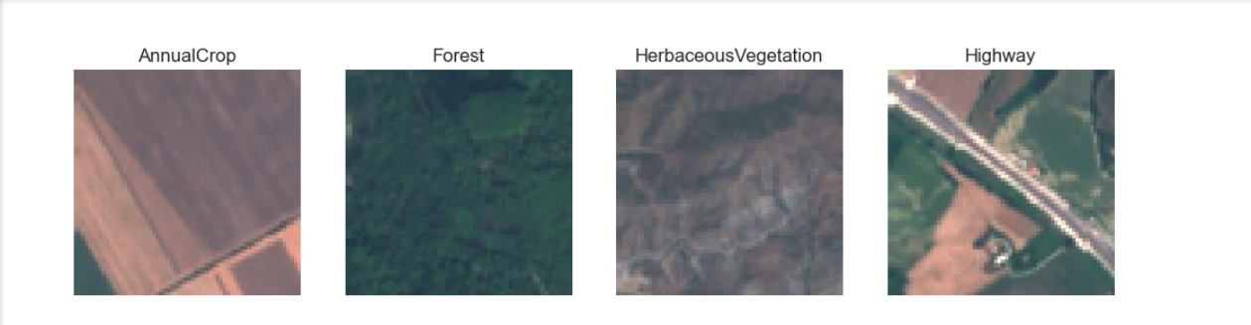
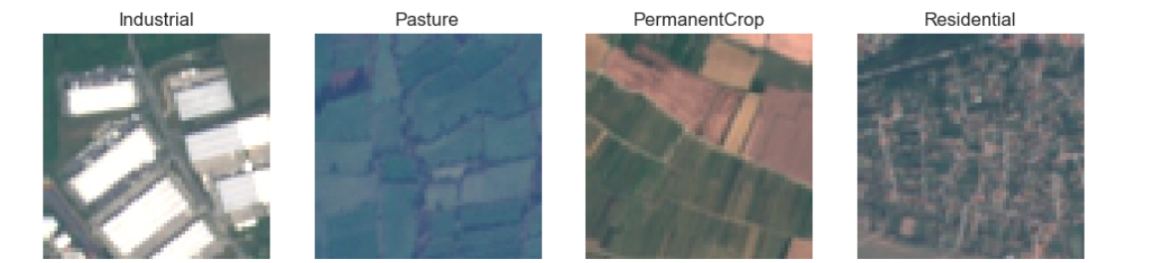
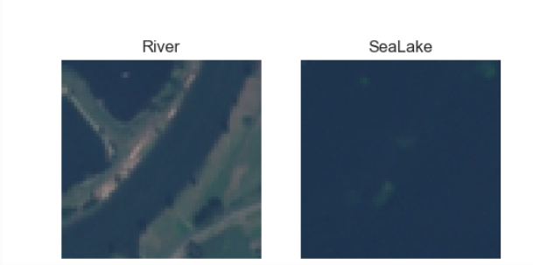
Collecting image samples from our dataset

Slide 7
WorkFlow
- **Data Collection**
- Gather satellite imagery or other relevant data sources for land cover classification.
- **Data Preparation**
- Clean and preprocess the data, including augmentation (like flipping and rotation) and normalization.
- **Model Building**
- Construct the CNN model, defining the architecture and key layers.
- **Model Training**
- Train the model with callbacks, monitor progress, and adjust hyperparameters as needed.
- **Model Evaluation**
- Validate and test the model, using performance metrics like accuracy, precision, and recall.
- **Model Deployment**
- Deploy the trained model, integrating it with business processes or other applications.
- **Business Implications**
- Identify business opportunities and risks, suggesting potential improvements for operational integration.

Slide 8
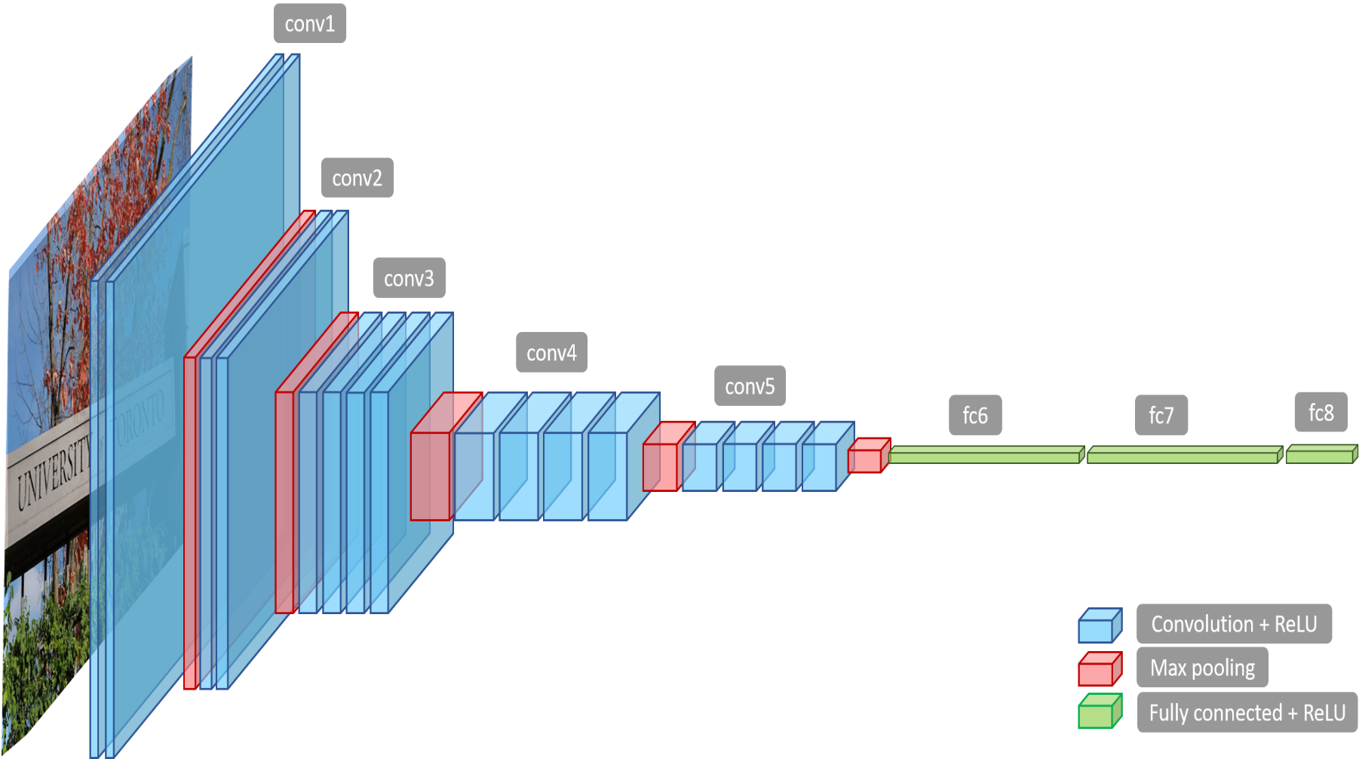
VGG19: Unveiling Complex Visual Patterns with Deep Convolutional Networks"

Slide 9
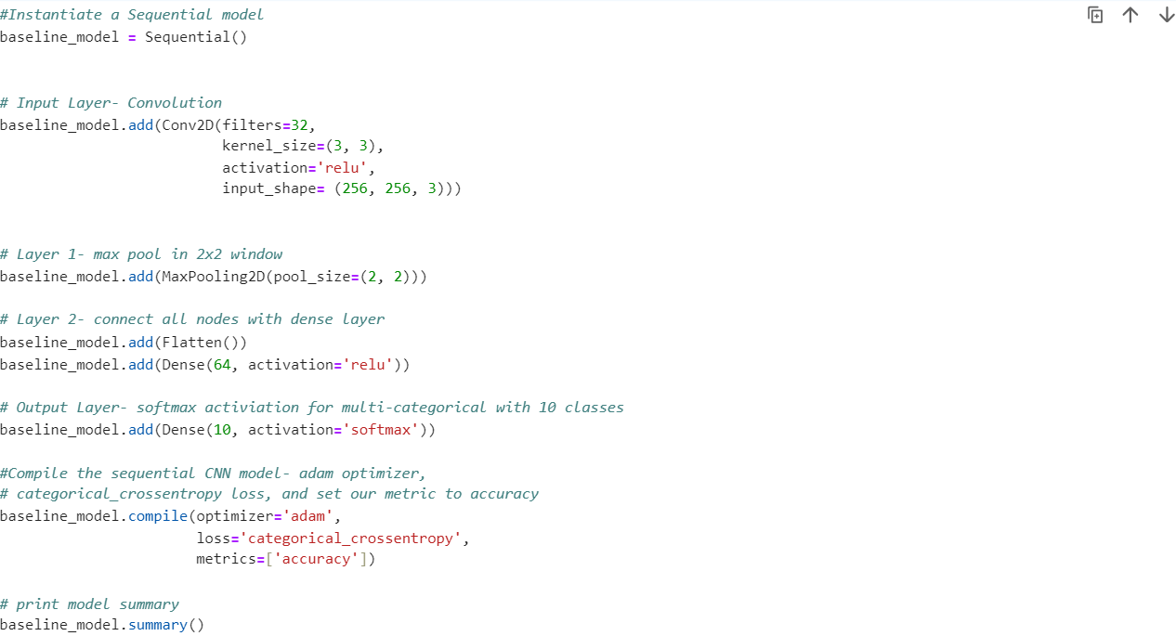
Building a Baseline CNN

Slide 10
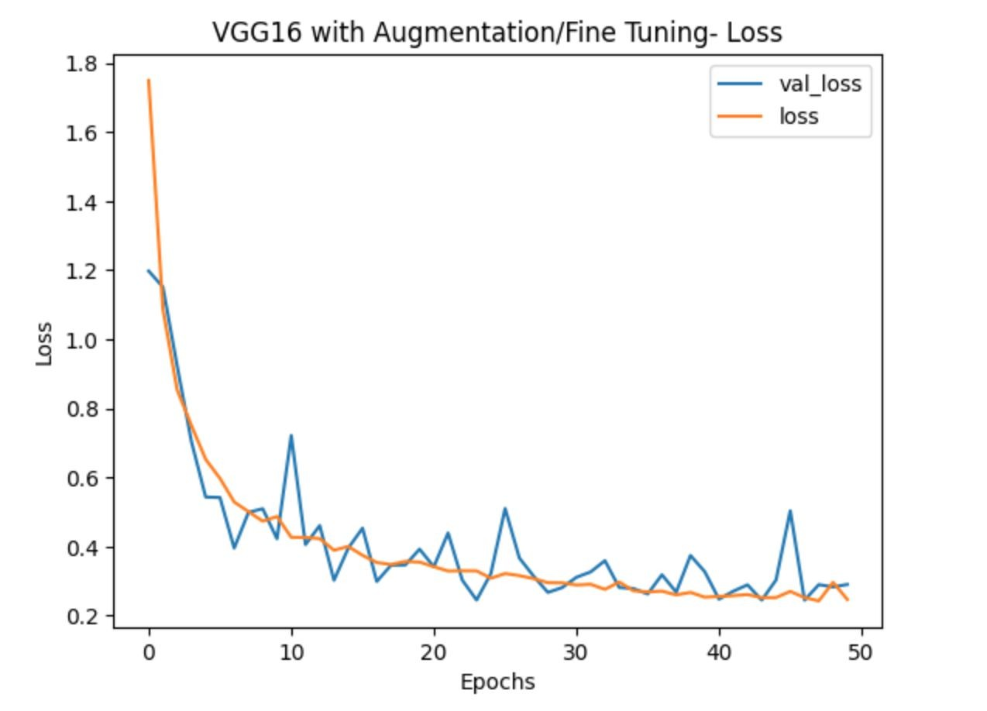
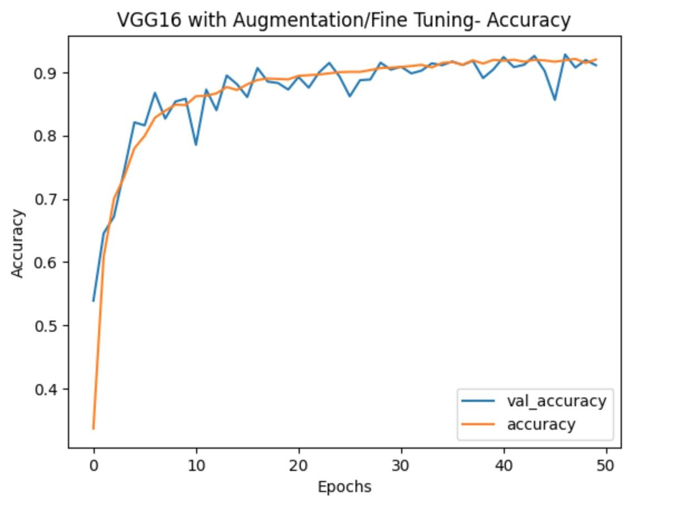
Results- Training
Best: Epoch 47
Train Accuracy: 91.90%
Validation Accuracy: 92.82%

Slide 11
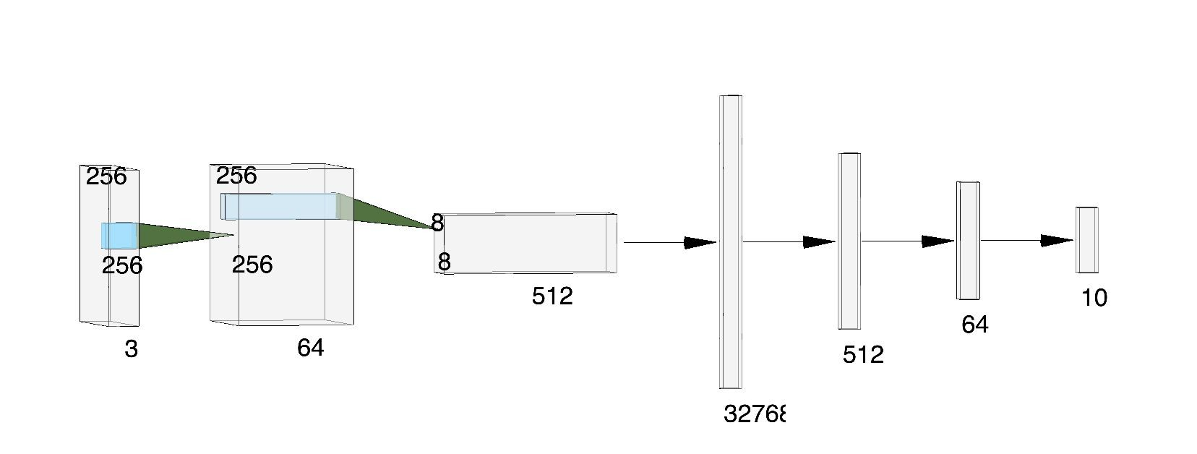
Final Model
Flatten
VGG16
Input
Input
VGG16
Output
Dense
^{Dense} Output
32768
Simplified Model Representation
Trainable Parameters: 23,890, 634
Overall Test Accuracy: 91.46%
Non-trainable Parameters: 7,635,264

Slide 12
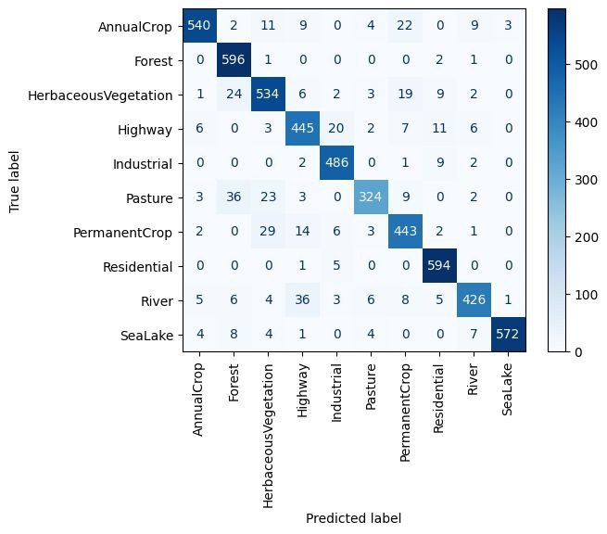
Test Accuracy by Class
Most Confused Classes:
Pasture as Forest
River as Highway

Slide 13
Business Understanding
The Nature Conservancy (TNC) is looking to help protect wildlife migration corridors from development/deforestation, but they can’t be everywhere at once.
In order to help them find where to focus their efforts, we want to build Land Cover Classifier so that TNC can monitor land use change using satellite images to observe if an area starts changing from forest or vegetation to another class.

Slide 14
Deforestation and Land Degradation
Forests contain:
60,000 tree species
80% of amphibian species
75% of bird species
68% of mammal species
Since 1990, ~420 million hectares of trees have been lost to agriculture and other land uses.
Data from The UN’s report The State of the World's Forests 2020

Slide 15
Out-The-Box Transfer Learning Models
Simple CNNs with Regularization
L1, L2, Dropout 26.6% to 65.6% Accuracy
ResNet50, VGG19, VGG16
28.6 % to 85.9% Accuracy
Baseline CNN
1 Max Pooling
1 Dense
74.1% Accuracy
Final Model
Fine Tuned VGG16 with Image Augmentation 91.46% Accuracy
Deeper CNNs
74.5% to 80.6% Accuracy
Methods

Slide 16
Recommendations
Use this land cover classifier tool on images of the same land area over time.
Focus deforestation prevention efforts on known wildlife corridor areas where an image’s class has changed over time.

Slide 17
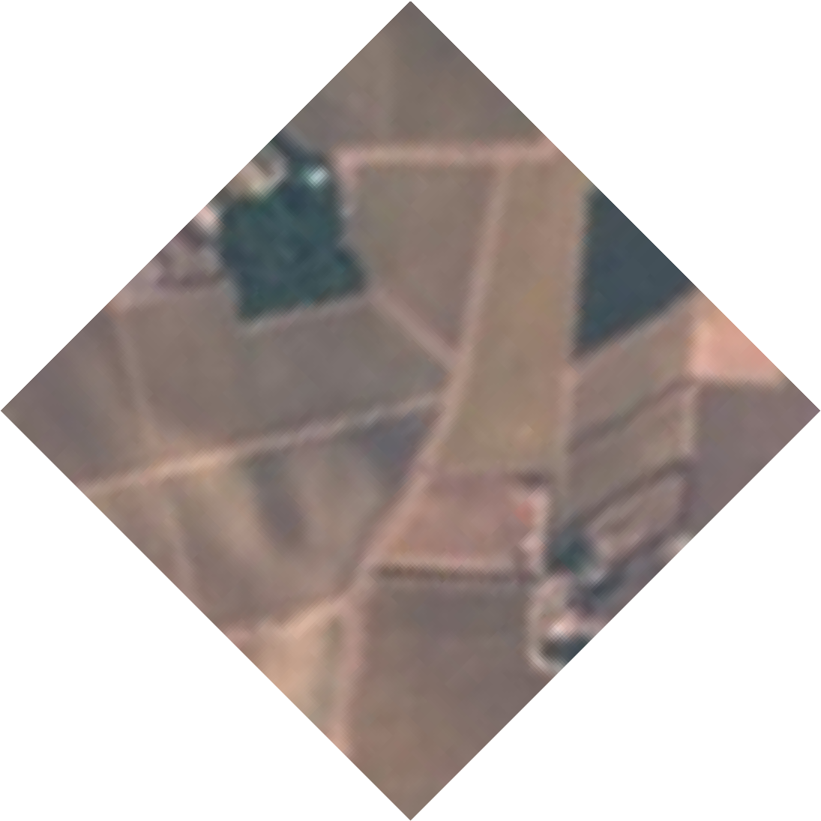
Next Steps
Refine model on confused classes (i.e. river and highway) possibly through preprocessing.
Create object detection to help classify multiple areas of land cover within an image.

Slide 18
Thankyou
Name – Sahil S Badve
Email – sahilbadve17@gmail.com
Linkedin – (26) Sahil Badve | LinkedIn
Github – Sahilbadve17 (github.com)

